Slide 1
Virtual Case Experience
Digital Intelligence
Model Work Task 5

Slide 2
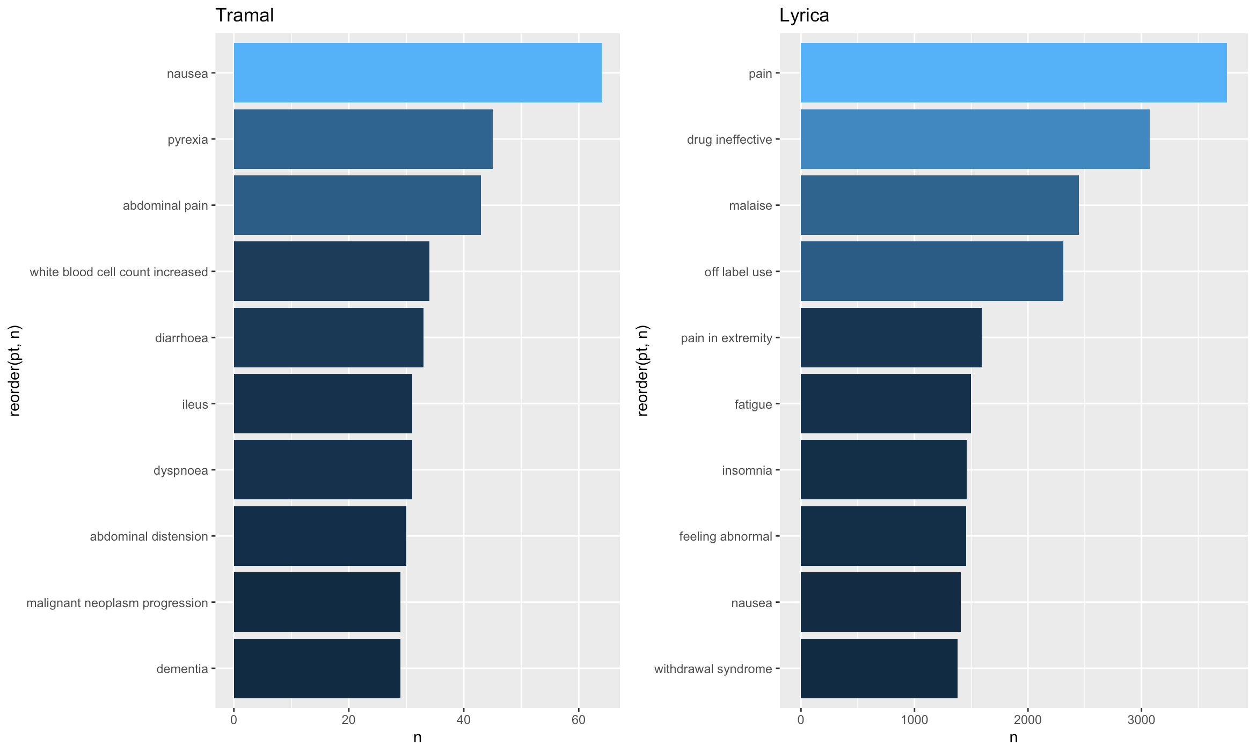

Descriptive overview
Please see the included R File as well to get the full overview.

Slide 3
Comparison of Tramal to Lyrica
The adverse effects of the two drugs seem to differ:
Top adverse effects for
TRAMAL
Nausea,
Pyrexia (Fever) and
Abdominal pain
Top adverse effects for
LYRICA
Pain,
Drug ineffective and
Malaise
The top two adverse effects of Lyrica seem to indicate, that a patient visits the doctor again because of sense pain and/or because of the feeling that the drug might not work as intended. This could be an indication that Lyrica might not be a proper drug against pain in many occasions.
On the other side, adverse effects of Tramal seem to show, that many patients get nausea. Considering the fact, that Tramal is usually prescribed for severe pain and that “pain” is not listed in the adverse effects, the conclusion can be made, that Tramal is actually working as intended. However, it also seems that there are more severe adverse effects that might prevent patients to take the drug long term.

Slide 4

Further investigations
Issue 1
What was the drug initially prescribed for? Does the adverse effect differ depending on that?
Issue 2
Issue 3
Do adverse effects of drugs depend on other factors such as demographic data of the patient?
Are there any adverse effects resulting from comedication?
Issue 4
Several issues need a closer look
Issue 5
Can adverse effects be treated by other drugs? In case of Tramal, a medication for nausea or pyrexia?
What are the long vs. short term adverse effects of the drugs?
Issue 6
What is the severity of the adverse effects on the overall well-being of the patient?
Issue 7
Issue 8
Can all causal adverse effects (especially long- term) be linked to current drug use?
Are certain adverse effects reported more than others and does that bias the data?

